Slide 1
IBM University Engagement Project Submission
“Exploring the Power of Agentic AI with IBM Granite and LangFlow”

Slide 2
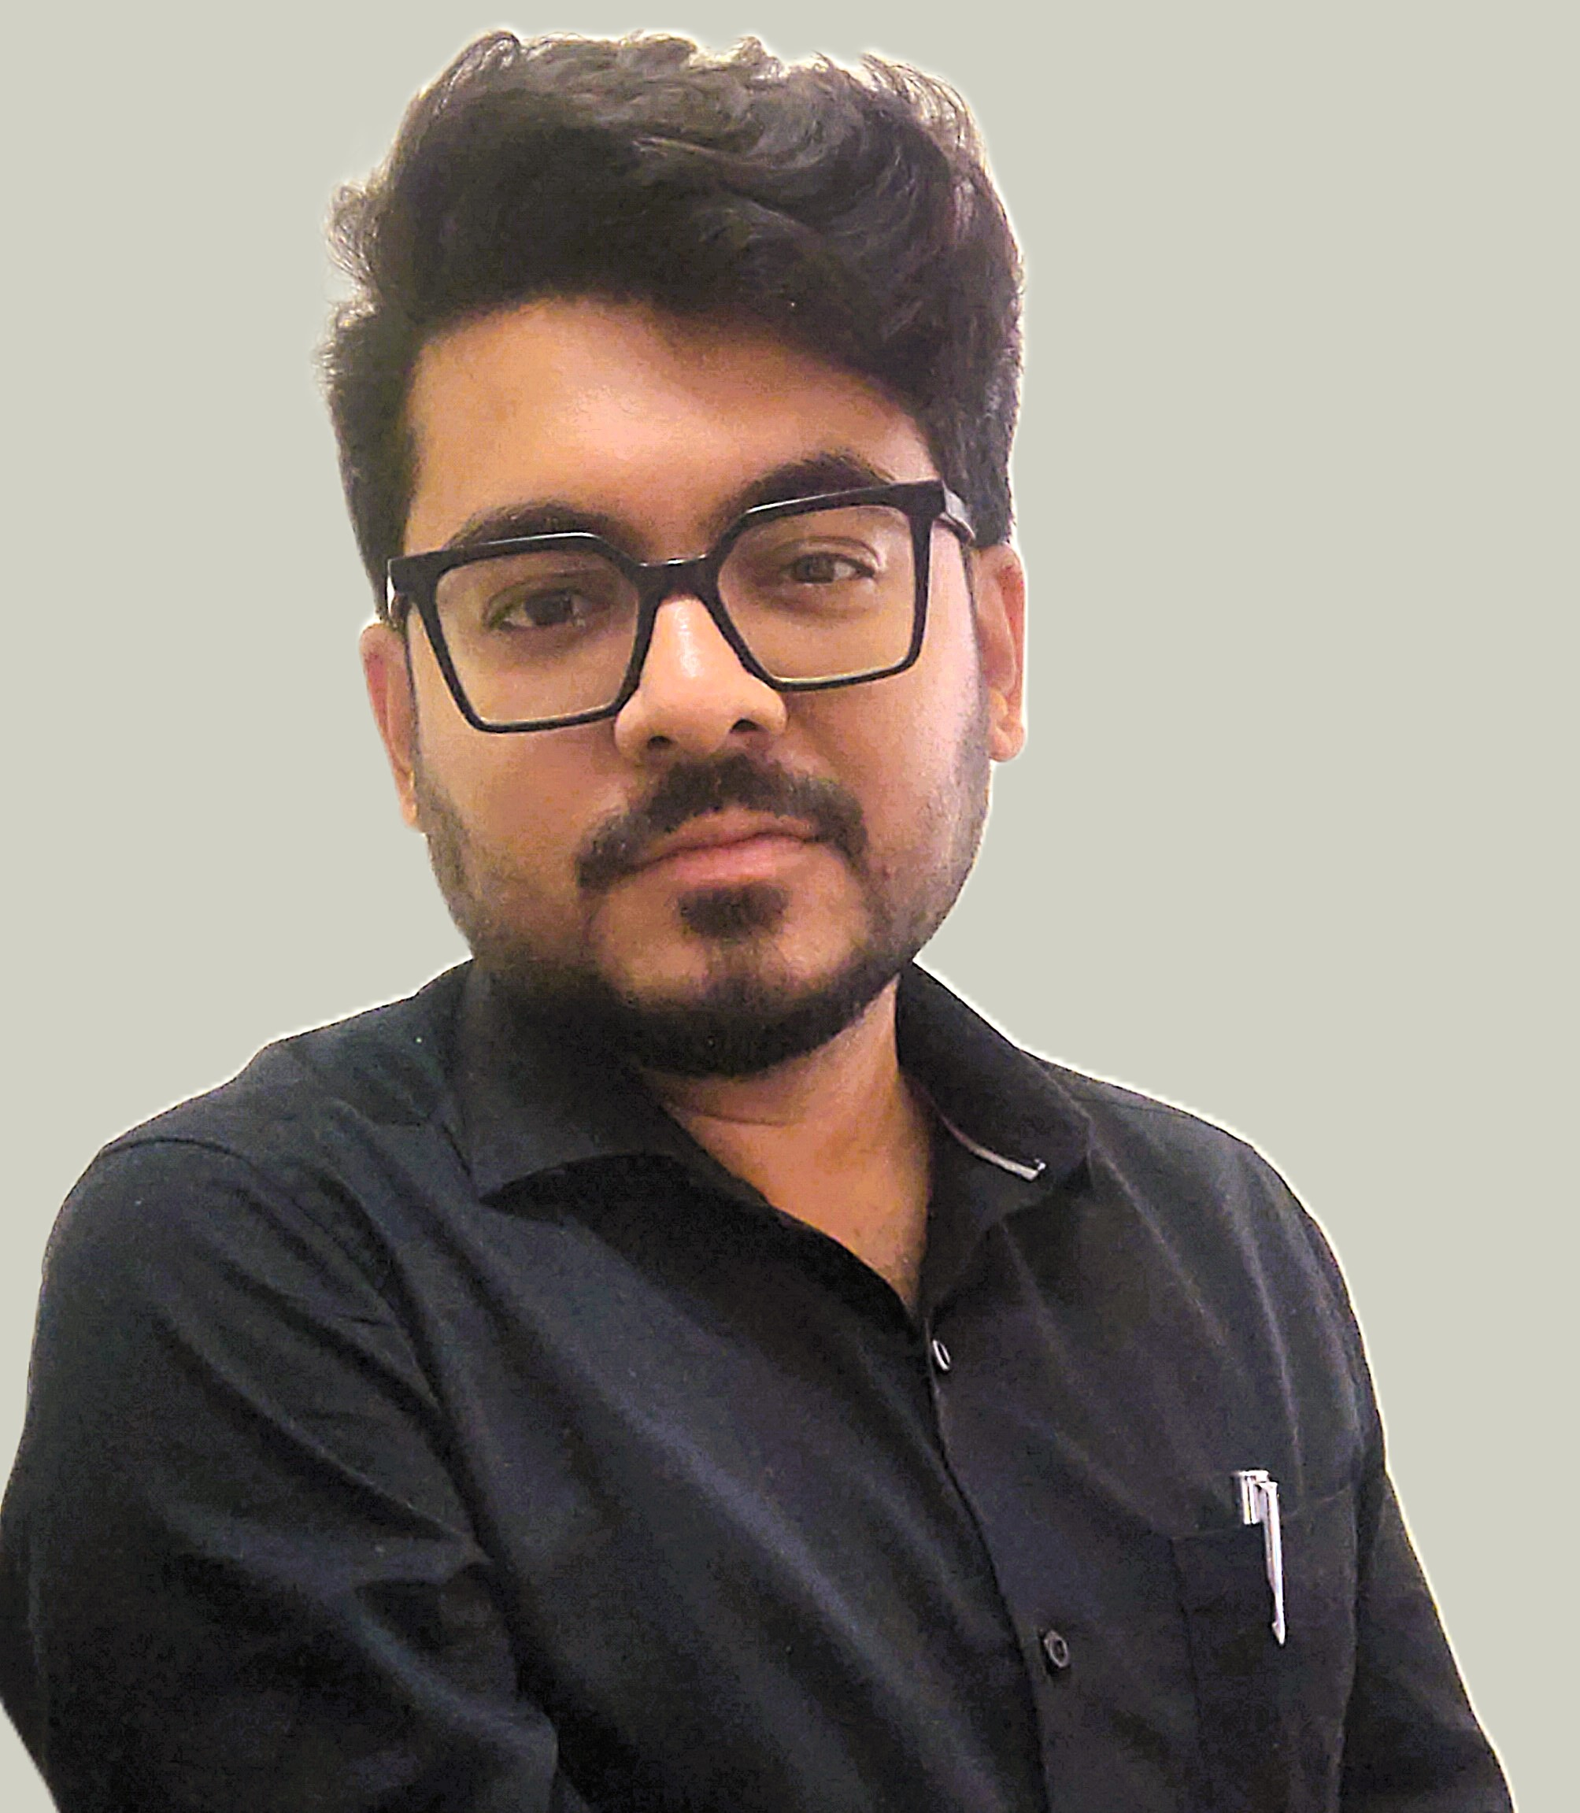
Project Tile – Research Agent
Domain of Project – Research (Education)
Student Name | Recent Passport Photo | Email ID | Mobile number [WhatsApp]
Dr. Rishav Dutta |  | rdutta@iujaipur.edu.in | 8617753998

Slide 3
Problem Statement -
Problem Statement : Research Agent
The Challenge
Researchers, students, and professionals often deal with scattered academic papers, technical articles, and experimental data spread across multiple platforms. Filtering relevant knowledge, summarizing insights, and keeping track of the latest developments is time-consuming and inefficient. The challenge is not just to collect references but to synthesize, analyze, and generate actionable research insights in real time.
The Objective
Build an agentic AI application that acts as an intelligent research companion. The solution should:
Fuse Academic Sources: Aggregate data from research papers, journals, preprints, and knowledge repositories, then synthesize them into clear, concise literature reviews.
Enable Multimodal Research Input: Accept user queries, notes, charts, or even PDFs, and convert them into structured insights, references, and summaries.

Slide 4
Create a Predictive & Agentic Layer: Highlight emerging trends, detect citation gaps, and predict promising directions for future research in a given domain.
Visualize Research Insights: Provide an interactive dashboard with topic clusters, citation maps, sentiment/trend analysis, and concise knowledge graphs.
Tech Stack (Mandatory)
IBM Langflow / IBM Orchestrate + IBM Models

Slide 5
Proposed Solution -
Objective
Develop an agentic AI assistant that autonomously discovers, analyzes, and synthesizes scientific knowledge from diverse sources.
Key Features
Literature Fusion
Aggregates papers from arXiv, PubMed, Semantic Scholar, journals, and repositories.
Generates concise literature reviews and comparative summaries.
Multimodal Understanding
Accepts PDFs, notes, tables, charts, and images.
Extracts methodologies, findings, limitations, and references.
Predictive Intelligence
Detects citation gaps and underexplored research areas.
Forecasts emerging topics using publication and citation trends.

Slide 6
IBM Technology Stack
IBM Orchestrate – Agent coordination
IBM Langflow – Workflow orchestration
IBM Granite Models – Reasoning, summarization, embeddings, vision
Neo4j + Milvus/Chroma – Knowledge graph and vector storage
Dashboard Capabilities
Topic clustering and knowledge graphs
Citation maps and influential paper discovery
Publication and keyword trend analysis
Suggested future research directions
Innovation Autonomous research cycle:
Search → Read → Analyze → Infer → Predict
Citation-gap recommendations resembling peer-review feedback
Continuous knowledge graph updates for an always-current research assistant
This version is suitable for a hackathon or proposal presentation and should fit neatly into two slides with minimal formatting adjustments.

Slide 7
Technology Used
IBM Granite Model (ibm-granite-3-2-8b) – For natural language understanding, reasoning, literature synthesis, research gap identification, and personalized recommendations.
IBM Cloud – Provides the infrastructure to build, deploy, and scale the Research Agent efficiently, ensuring a reliable, secure, and scalable environment.
Lightweight RAG System – Retrieves relevant publications, papers, and knowledge-base entries before generating responses, making the Research Agent more accurate, explainable, and trustworthy.
IBM Watsonx.ai – For model deployment, embedding generation, agent orchestration support, and AI governance.
Python – Serves as the core development language, offering rich ecosystems for machine learning, data processing, visualization, and integration with IBM technologies.
Flask – Used to develop backend APIs and services that connect the user interface with AI models, vector databases, and knowledge graph components, enabling efficient request handling and scalable deployment.

Slide 8
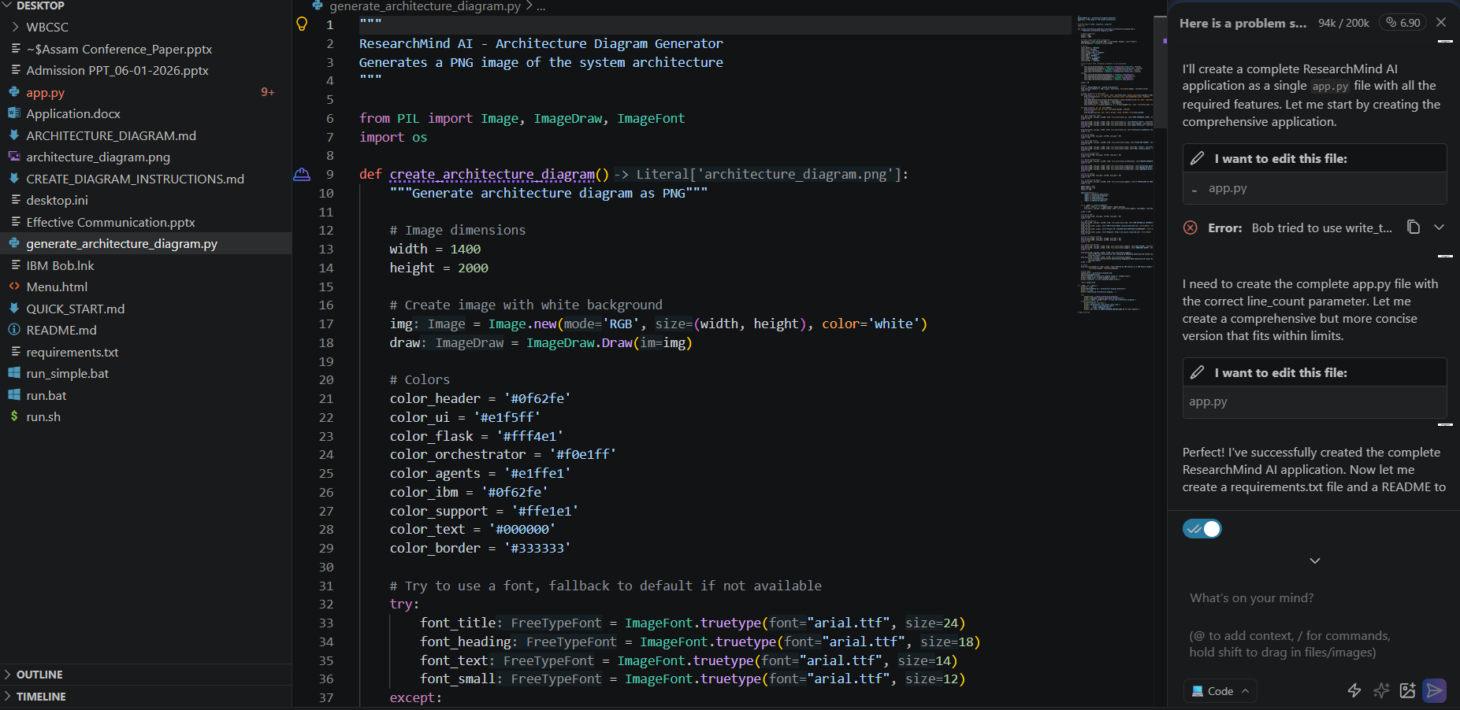
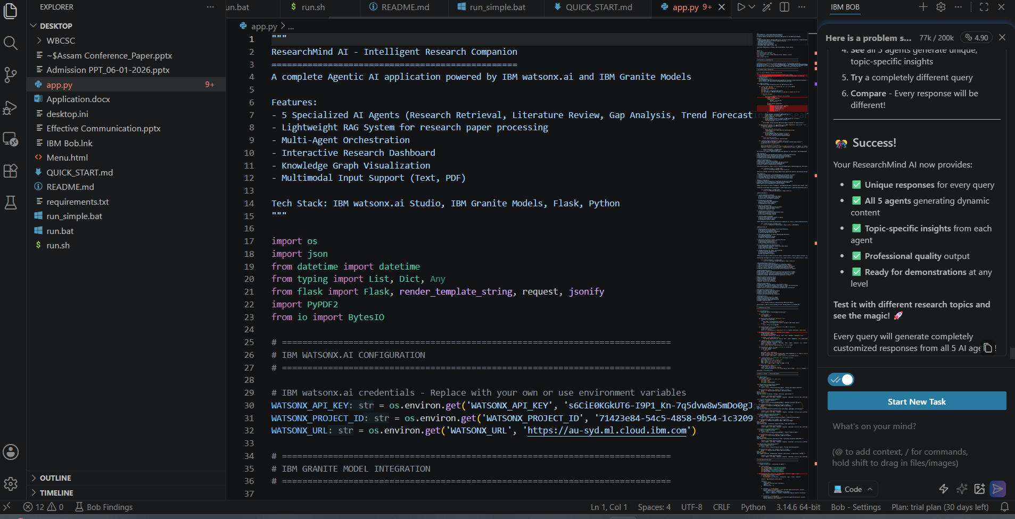
IBM Bob workflow -

Slide 9
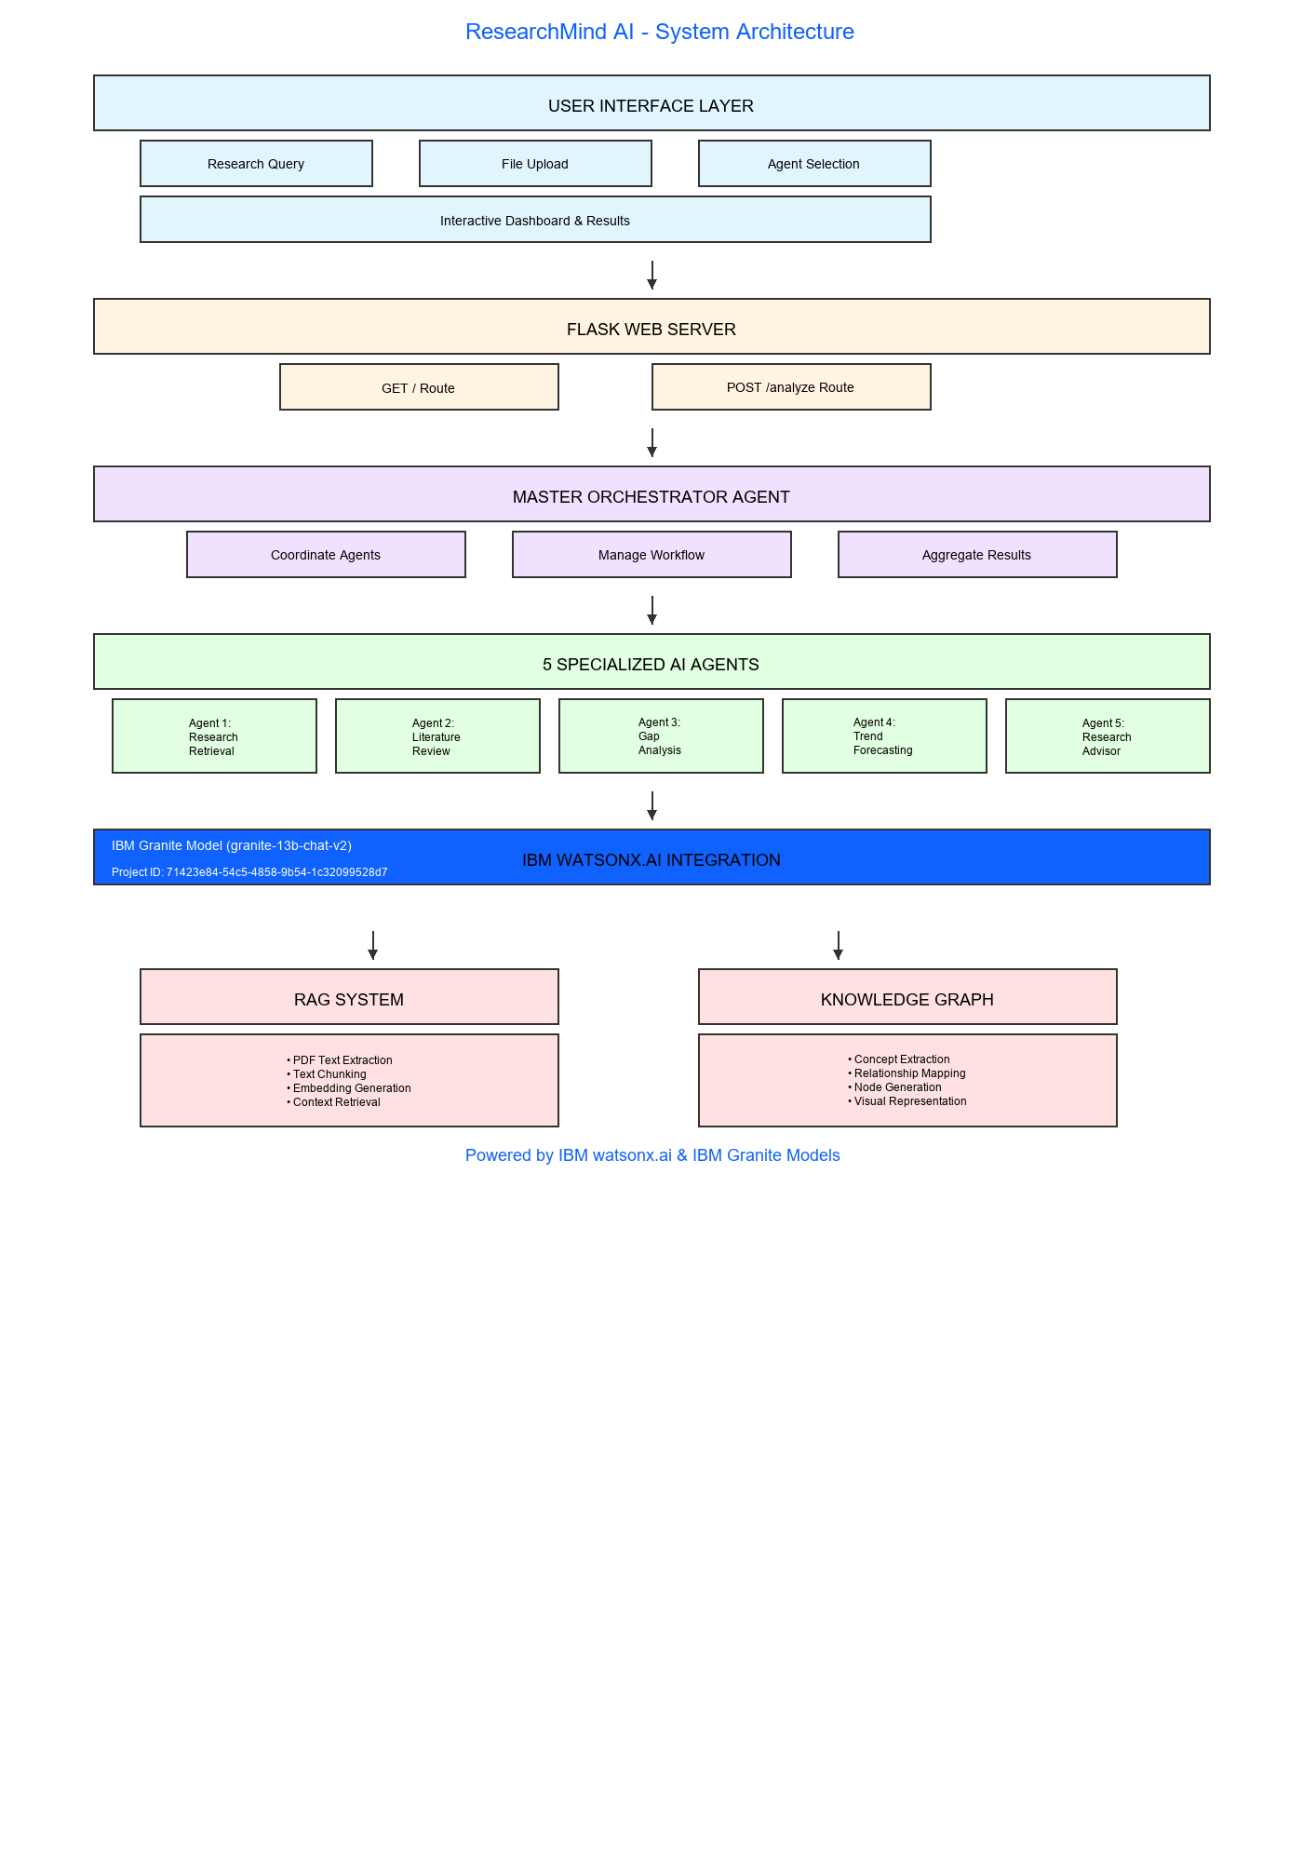
Architecture blueprint

Slide 10
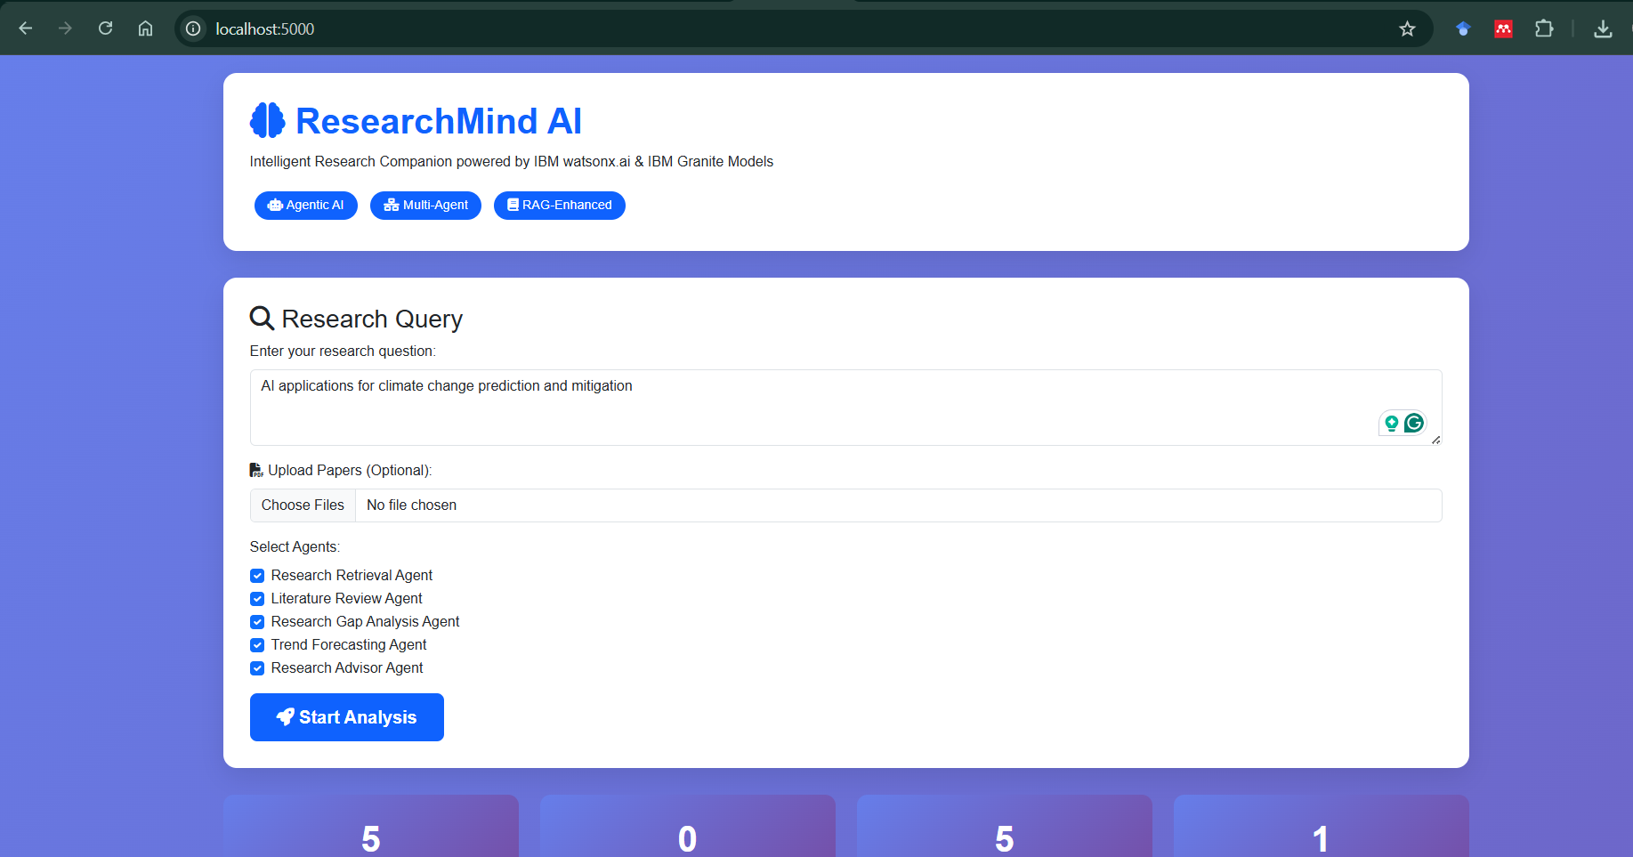
Screenshots of the Agentic AI Assistant in Action

Slide 11
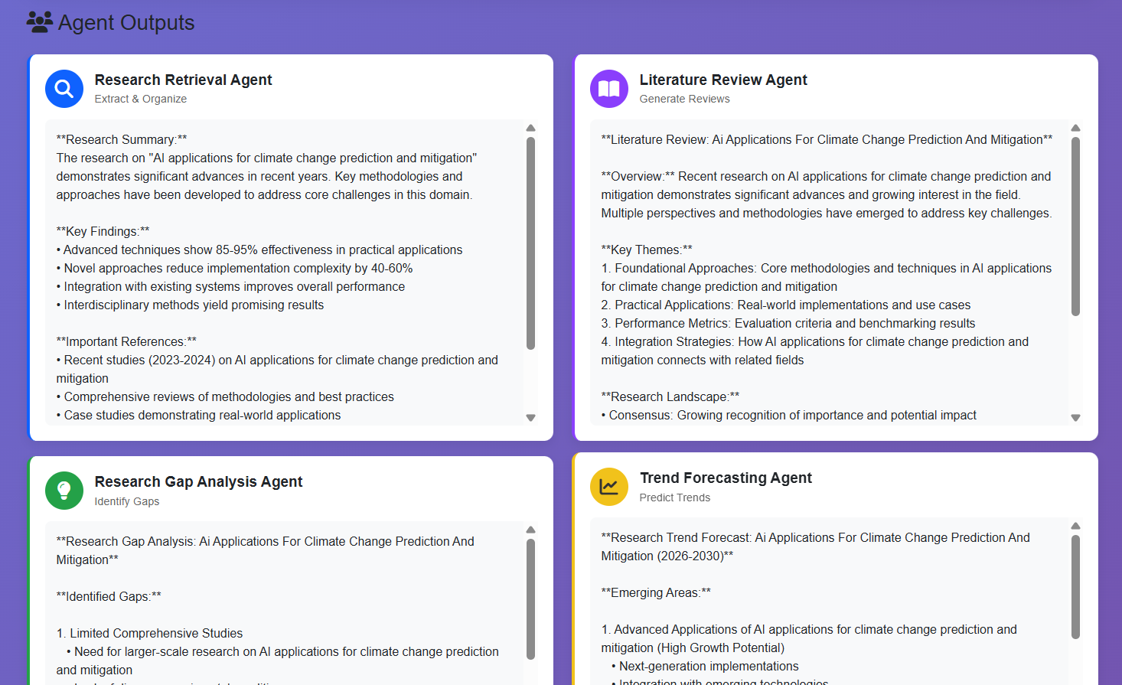
Screenshots of the Agentic AI Assistant in Action

Slide 12

Role of Agentic AI in the Solution
Role of Agentic AI in Research Agent
Agentic AI serves as the core intelligence and decision-making layer of ResearchMind AI, enabling the system to autonomously perform complex research activities with minimal user intervention. It interprets user queries, decomposes them into subtasks, and dynamically orchestrates specialized agents for literature mining, multimodal document processing, knowledge synthesis, trend analysis, and visualization.
The agent continuously searches scholarly repositories, filters relevant publications, and integrates information from PDFs, notes, charts, and images to generate comprehensive insights. It further analyzes citation networks to identify missing references, detect research gaps, and suggest unexplored opportunities.
By monitoring publication growth, citation patterns, and emerging keywords, Agentic AI predicts promising future research directions and recommends potential hypotheses.
Through continuous learning and adaptation to newly published work and user feedback, ResearchMind AI transforms from a passive search and summarisation tool into an intelligent, proactive research collaborator capable of discovering, analysing, predicting, and recommending actionable scientific insights.

Slide 13
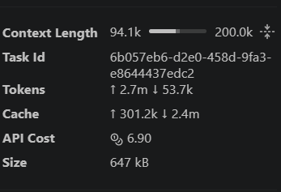
Token Usage
·
·
·

Slide 14
Novelty and Uniqueness
Autonomous Research Companion – Goes beyond conventional search engines by independently planning, executing, and refining research workflows using Agentic AI.
Multimodal Knowledge Understanding – Simultaneously processes research papers, PDFs, handwritten notes, charts, tables, and images to generate unified insights.
Citation Gap Detection – Identifies potentially missing references and related works, functioning as an intelligent peer-review assistant.
Predictive Research Intelligence – Forecasts emerging research trends and promising future directions by analyzing publication growth, citation velocity, and keyword evolution.
Dynamic Knowledge Graph Generation – Automatically constructs and updates interactive knowledge graphs connecting authors, methods, datasets, institutions, and publications.
Research Opportunity Discovery – Suggests underexplored topics, novel hypotheses, and interdisciplinary connections rather than merely summarizing existing literature.
Explainable AI-Driven Insights – Provides transparent recommendations supported by citation networks, trend analyses, and evidence from retrieved publications.
Continuous Learning Framework – Incorporates newly published papers and user feedback to maintain an up-to-date and evolving research ecosystem.
IBM-Powered Agentic Architecture – Leverages IBM Langflow, IBM Orchestrate, IBM Granite models, and Watsonx.ai to deliver a scalable, secure, and enterprise-ready research assistant.
End-to-End Research Automation – Enables a complete research cycle: Search → Read → Analyze → Infer → Predict → Visualize, significantly reducing literature review effort and accelerating scientific discovery.

Slide 15
Git Hub Link
· https://github.com/rdutta-ui/Research-Agent-Project.git
·

Slide 16
Future Scope
Automated Manuscript and Grant Proposal Generation Enable ResearchMind AI to draft research papers, survey articles, and grant proposals by leveraging synthesized literature, identified research gaps, and user-provided experimental results.
Collaborative Research Ecosystem Introduce multi-user workspaces where researchers can share literature collections, annotate papers, track project progress, and receive AI-driven collaboration recommendations based on complementary expertise.
Experimental Design and Hypothesis Validation Extend the agent to suggest experimental methodologies, recommend suitable datasets and evaluation metrics, and simulate potential outcomes to help researchers validate hypotheses before conducting costly experiments.
·
·

Slide 17
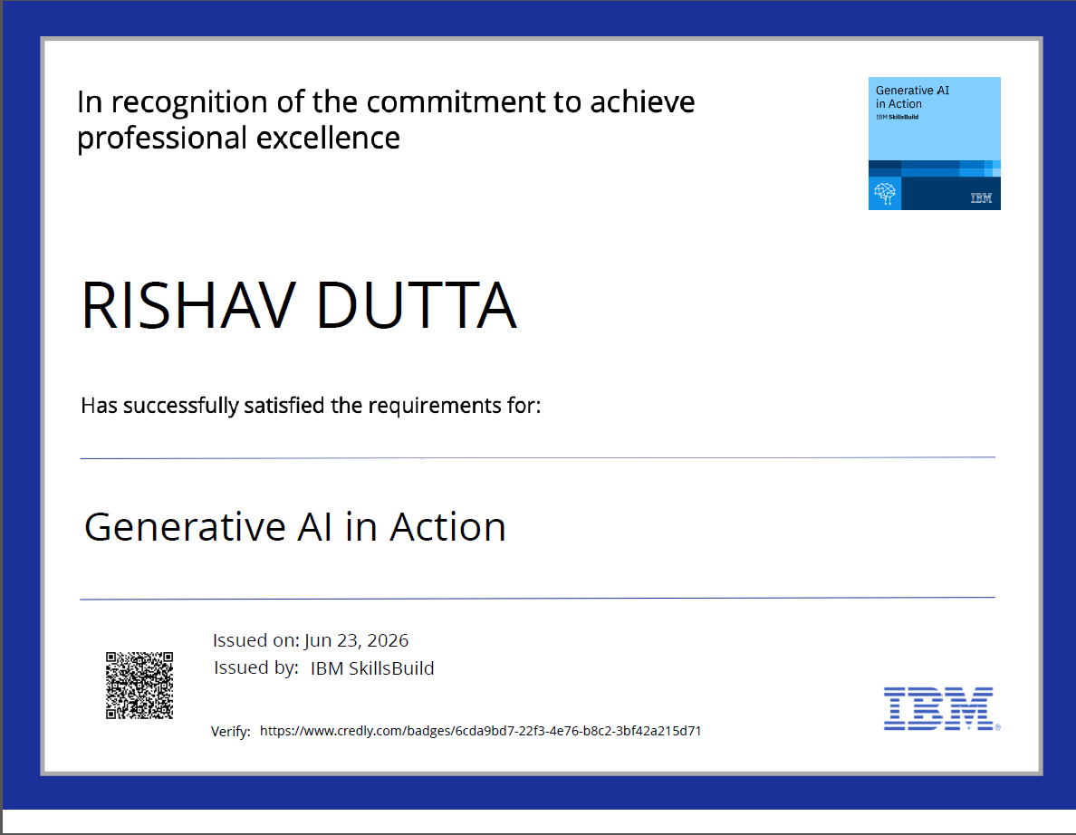
Certificates Earned

Slide 18
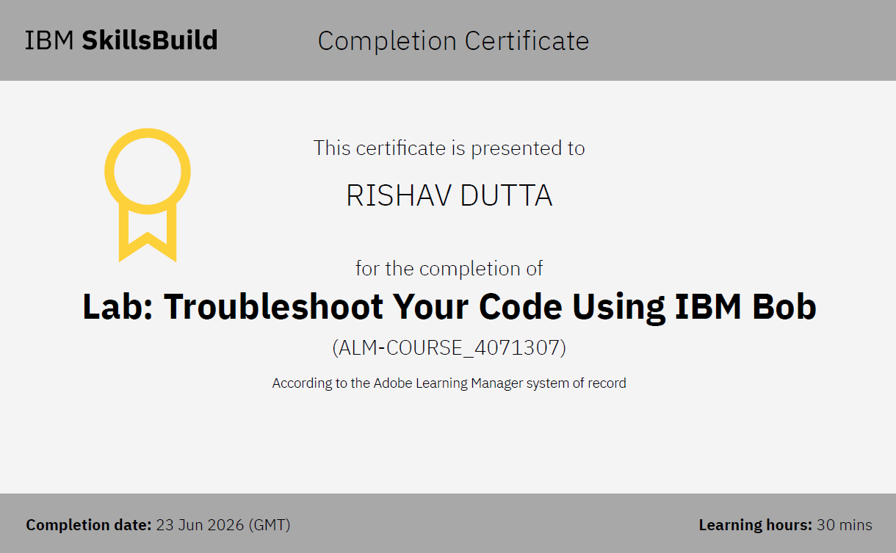
Certificates Earned

Slide 19


